Slide 1


JavaScript

Slide 2
Table of Contents:
1
Introduction to JavaScript
11
Higher-order Function
Modules
1 day
1 day
21
1 day
Data Types and Variables
Objects
3 day
2
1 day
12
1 day
22
JSON, AJAX and API
3
String in JavaScript
DOM
2 day
N
13
6 day
23
Promise and Fetch API
Operators in JavaScript
1 day
4
1 day
14
BOM
Intersection Observer
2 day
24
5
Numbers and Number Methods
Destructuring
1 day
15
1 day
6
String Methods
Set and Map
1 day
16
1 day
7
Conditional Statements
17
Array Methods 2
2 days
1 day
Arrays and Array Methods
18
Regular Expressions
8
1 day
2 day
9
Loops
19
OOP
2 day
1 day
2 day
1 day
10
Functions and Scope
20
Date and Time

Slide 3
How to Get the most out of this Course
Attend Every Class
Come to class on time
Listen carefully to explanations
Take short notes
Do not miss lessons
Practice Every Day
JavaScript needs practice
Write code every day
(even 20–30 minutes)
Do not only read —
type the code yourself
Understand, Don’t Memorize
Try to understand why the code works
If you don’t understand, ask questions
Use comments in your code to explain it
Make Mistakes (This Is Good!)
Errors are normal in programming
Read error messages carefully
Fix one problem at a time
Do All Assignments
Submit assignments on time
Follow instructions carefully
Do your own work (no copy-paste)
Review After Class
Re-read your notes
Re-run examples from class
Improve your old code
Help Each Other
Discuss with classmates
Search documentation (MDN)
Be Patient and Consistent
Learning JavaScript takes time
Do not give up
Practice + patience = success

Slide 4
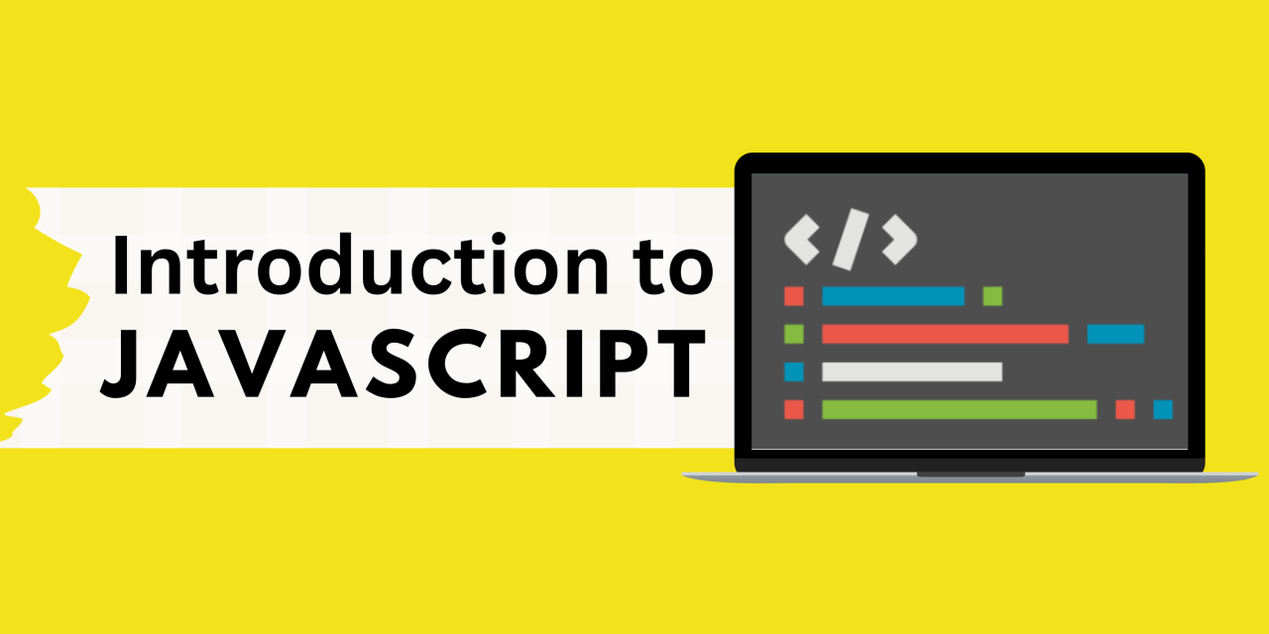

Slide 5
What we Cover Today:
01
02
03
04
05
Introduction to JS
Outputs and Comments
EcmaScript
History of JS
Exercise

Slide 6
Introduction to JS
JavaScript is Scripting Language or Programming Language
JavaScript is a programming language mainly used to make web pages interactive. It runs in your web browser and allows websites to:
Respond to user actions (like clicks, mouse movement, typing, etc.)
Update content without refreshing the page
Animate elements (like sliders, menus, or popups)
Communicate with servers to get or send data (like in chat apps or online forms)
Note: Scripting Language Is like a helper language — it makes it easy to write quick programs that automate tasks or interact with other software.

Slide 7
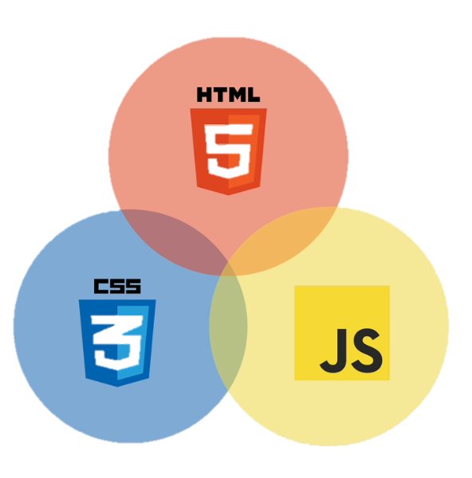
The role of JS in Web Development

Slide 8
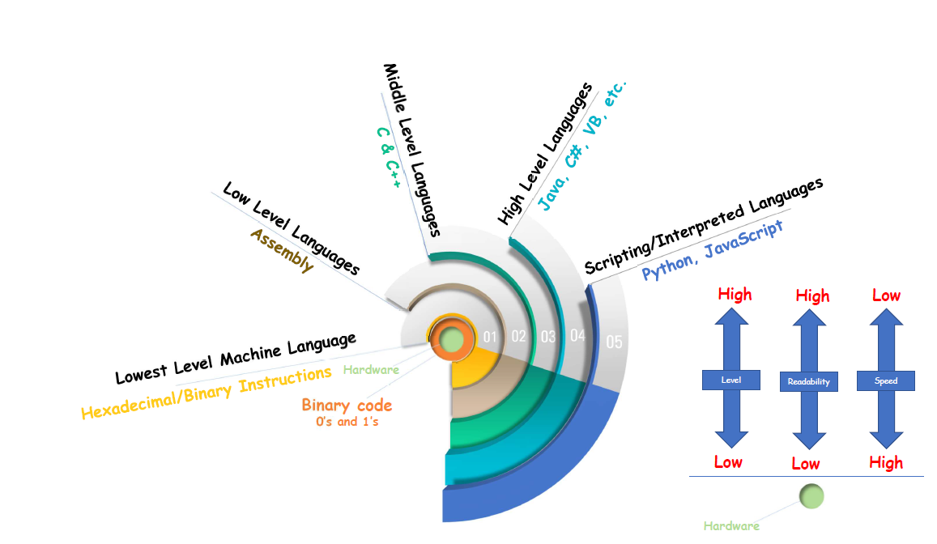

Slide 9
Introduction to JS
What JavaScript Can Do?
Dynamically Update Content
Manipulating HTML and CSS
Animate images and Content and Create image Gallery
Manipulate and Validate Data
Control Multimedia (Audio, Video, Etc)
Web Browser games, Mobile Apps, Desktop Apps

Slide 11
Introduction to JS
How Add JavaScript to Web Pages
To add JavaScript to your web pages, you can use one of these three main methods:
Inline JavaScript (inside HTML tags)
<button onclick="alert('Hello!')">Click me</button>
Use this only for very small scripts, it's not ideal for real projects.
Internal or Embedding JavaScript (inside <script> tag)
<script>
function sayHi() {alert("Hi from internal script!");}
</script>
Put your <script> tags at the bottom of the <body> to ensure the page loads first.

Slide 12
Introduction to JS
External JavaScript File
Put your JavaScript in a separate .js file and link it using the <script> tag.
<script src="mian.js"></script>

Slide 13
Outputs & Comments
Outputs
JavaScript can Display data in four ways:
document.write()
Use document.write() to directly write to the HTML document.
document.write(“<h1>Hello, world!</h1>");
Not recommended for modern websites (can overwrite your page if used after it loads).

Slide 14
Outputs & Comments
Alert Box
Use alert() to show a popup box with a message.
alert("Hello, user!");
Good for quick messages, but not ideal for modern UX.
Console Output
Use console.log() to show output in the browser’s developer console (for debugging).
console.log("This is a message for developers.");
Most common way to test and debug JavaScript code.

Slide 15
Outputs & Comments
HTML DOM Output (Dynamic Page Update)
Change the content of HTML elements using innerHTML.
<p id=“paragraph">Khalid</p>
document.getElementById("paragraph").innerHTML = “Guuled, Ali iyo Anas";
Best way to show output directly in the webpage dynamically.

Slide 16
Outputs & Comments
Styling The JavaScript Console
In JavaScript, you can use console.log() with CSS styles to make console messages look better and useful for debugging, grouping logs, or highlighting warnings.
How it Works
Use the %c format in console.log() to apply CSS styles to part of the message.
console.log(‘%cKhalid Abdirahman', 'color: red; font-size: 20px; font-weight: bold;');

Slide 17
Outputs & Comments
Multiple Styled Parts
You can use multiple %c tokens to style different parts of the same log:
console.log(
'%cSuccess:%c The operation was completed.',
'color: green; font-weight: bold;',
'color: black;'
);

Slide 18
Outputs & Comments
Comments
JavaScript comments can be used to explain JavaScript code, and to make it more readable.
JavaScript comments can also be used to prevent execution, when testing alternative code.

Slide 19
Outputs & Comments
Types of JS Comments
Single-line Comment
Starts with // and anything after it on the same line is a comment.
// This is a single-line comment
let name = "Khalid"; // This sets the name
Multi-line Comment
Multi-line comments start with /* and end with */.
Any text between /* and */ will be ignored by JavaScript.

Slide 20
ECMAScript
ECMAScript (or ES) is the official standard that defines how the JavaScript language should work.
In Simple words:
ECMAScript is the set of rules for JavaScript
It tells browsers and computers how JavaScript should behave.
Every new version of ECMAScript adds new features to JavaScript

Slide 21
ECMAScript
Why ECMAScript Exits?
In the 1990s, different browsers like Netscape and Internet Explorer started adding their own versions of JavaScript. This caused compatibility problems for developers.
To fix this, in 1997, a group called ECMA International created a standard called ECMAScript, so that all browsers could follow the same rules for JavaScript.
Note: ECMA = European Computer Manufacturers Association

Slide 22
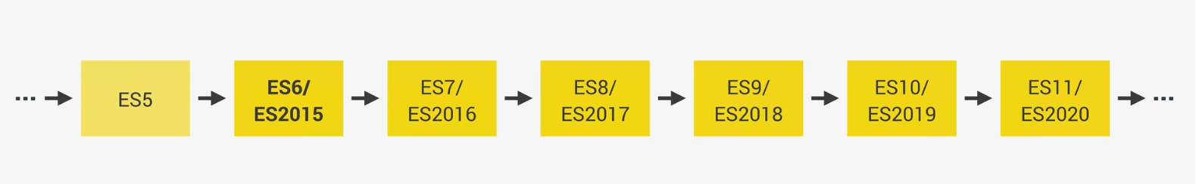
ECMAScript
Version | Year | Key Features
ES1 | 1997 | First official version
ES5 | 2009 | strict mode, JSON, array methods
ES6 / ES2015 | 2015 | let, const, arrow functions, classes, modules, promises
ES2016+ / ES6+ | 2016–now | Yearly updates: async/await, optional chaining (?.), nullish coalescing (??), top-level await, etc.

Slide 23



History of JavaScript
1995
Brendan Eich creates the very first version of JavaScript in just 10 days. It was called Mocha.
1996
Mocha changes to LiveScript and then to JavaScript, in order to attract Java developers. However, JavaScript has almost nothing to do with Java
Microsoft launches IE, copying JavaScript from Netscape and calling it JScript;
1997
With a need to standardize the language, ECMA releases ECMAScript 1 (ES1), the first official standard for JavaScript (ECMAScript is the standard, JavaScript the language in practice);

Slide 24
History of JavaScript
2009
ES5 (ECMAScript 5) is released with lots of great new features;
2015
ES6/ES2015 (ECMAScript 2015) was released: the biggest update to the language ever!
ECMAScript changes to an annual release cycle in order to ship less features per update
2016 - ∞
Release of ES2016 / ES2017 / ES2018 / ES2019 / ES2020 / ES2021 / ... / ES2089

